Slide 1
John 14:15-27
15"If you love me, you will obey what I command. 16And I will ask the Father, and he will give you another Counselor to be with you forever-- 17the Spirit of truth. The world cannot accept him, because it neither sees him nor knows him. But you know him, for he lives with you and will be in you. 18I will not leave you as orphans; I will come to you. 19Before long, the world will not see me anymore, but you will see me. Because I live, you also will live. 20On that day you will realize that I am in my Father, and you are in me, and I am in you.

Slide 2
John 14:15-27
21Whoever has my commands and obeys them, he is the one who loves me. He who loves me will be loved by my Father, and I too will love him and show myself to him." 22Then Judas (not Judas Iscariot) said, "But, Lord, why do you intend to show yourself to us and not to the world?" 23Jesus replied, "If anyone loves me, he will obey my teaching. My Father will love him, and we will come to him and make our home with him.

Slide 3
John 14:15-27
24He who does not love me will not obey my teaching. These words you hear are not my own; they belong to the Father who sent me. 25"All this I have spoken while still with you. 26But the Counselor, the Holy Spirit, whom the Father will send in my name, will teach you all things and will remind you of everything I have said to you. 27Peace I leave with you; my peace I give you. I do not give to you as the world gives. Do not let your hearts be troubled and do not be afraid.

Slide 4
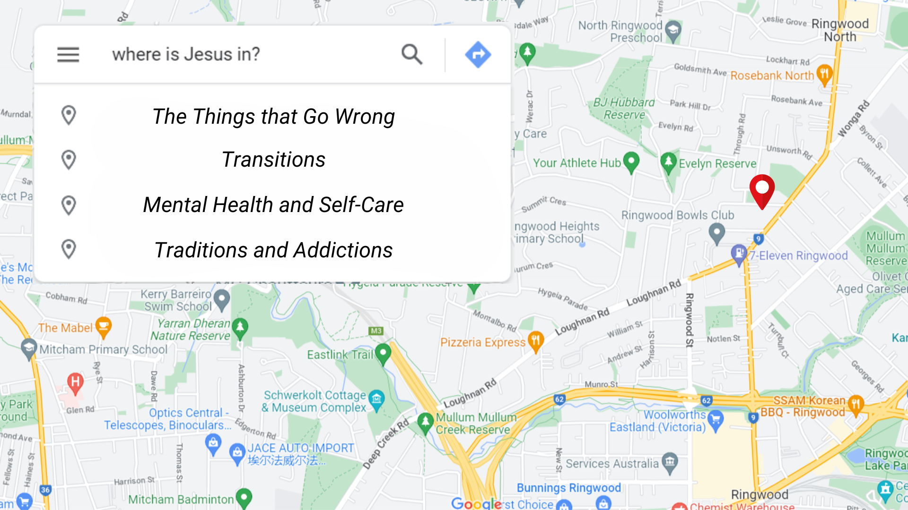

Slide 5
Transitions
Family life
School life
Life with loss
Change in worklife
Location change

Slide 6
John 14:15-31
15 “If you love me, keep my commands. 16 And I will ask the Father, and he will give you another advocate to help you and be with you forever— 17 the Spirit of truth. The world cannot accept him, because it neither sees him nor knows him. But you know him, for he lives with you and will be[c] in you. 18 I will not leave you as orphans; I will come to you. 19 Before long, the world will not see me anymore, but you will see me. Because I live, you also will live. 20 On that day you will realize that I am in my Father, and you are in me, and I am in you.

Slide 7
Luke 14:15-31
21 Whoever has my commands and keeps them is the one who loves me. The one who loves me will be loved by my Father, and I too will love them and show myself to them.”
22 Then Judas (not Judas Iscariot) said, “But, Lord, why do you intend to show yourself to us and not to the world?”
23 Jesus replied, “Anyone who loves me will obey my teaching. My Father will love them, and we will come to them and make our home with them. 24 Anyone who does not love me will not obey my teaching. These words you hear are not my own; they belong to the Father who sent me.

Slide 8
John 14:15-31
25 “All this I have spoken while still with you. 26 But the Advocate, the Holy Spirit, whom the Father will send in my name, will teach you all things and will remind you of everything I have said to you. 27 Peace I leave with you; my peace I give you. I do not give to you as the world gives. Do not let your hearts be troubled and do not be afraid.
28 “You heard me say, ‘I am going away and I am coming back to you.’ If you loved me, you would be glad that I am going to the Father, for the Father is greater than I. 29 I have told you now before it happens, so that when it does happen you will believe. 30 I will not say much more to you, for the prince of this world is coming. He has no hold over me, 31 but he comes so that the world may learn that I love the Father and do exactly what my Father has commanded me.
^{“Come now; let us leave.}

Slide 9
The First Promise
I Will send another advocate
  Another – Heteros or Allos: Another (but Different), Another (the same as)
  Advocate – Parakletos: One that walks alongside.

Slide 10
The Spirit of Truth
One function Jesus describes this advocate doing is:
  Bringing us closer to perceiving the ultimate spiritual reality.

Slide 11
The Second Promise
I will not leave you orphaned.
  Orphaned in this sense means abandoned, or left unprotected and therefore on their own

Slide 12
Special gift
A gift of faith, that separates apart from the world in which we exist.
A Faith to declare that God upholds his promises

Slide 13
A directive or instruction
Follow my Commands:
  These commands are already given, they are even written down for us

Slide 14
Another way in which the Spirit Helps
The spirit teaches us and reminds us of the full truth.

Slide 15
The Last promise
Jesus gives us everlasting peace that he has won for us, if we choose to accept it.

Slide 16
The Promises
He will send another advocate like himself
He will not abandon us or leave us unprotected
The advocate will remind us of Jesus’ teachings
He will give us an everlasting peace.

Slide 17
The instruction
We are to follow his commands, even if believe we haven’t received new ones the old ones still stand.
The comfort is that they are given and available whenever we need them.

Slide 18
The Challenge
Find a command in the new testament that Jesus gives, mediate or reflect on it and how it would work in your life.
Try to practice it this week.

